Slide 1

ECEN 3593-001 Computer Organization
Lecture #17
26 February 2021

Slide 2


Agenda
Class Announcements
Phase 5
Pipeline continued

Slide 3
Class Announcements
Reading for the week
“Computer Organization and Design, The Hardware / Software Interface, RISC-V edition,” by David Patterson and John Hennessy
ISBN 978-0-12-812275-4
Chapter 4, “The Processor”
pages 236-314 (sections 4.1 thru 4.8)

Slide 4
Class Announcements
Phase 5 is available, Target Date Sunday, February 28 at 10:00 PM
1%/day bonus before that, 4%/day penalty after
Phase 6 is posted
Target Date Sunday, March 7 at 10:00 PM
1%/day bonus before that (maximum 7%), 4%/day penalty after
Separate schematic and Codasip pieces

Slide 5
Class Announcements
I will have Zoom OH today from 2:00 to 3:00 https://cuboulder.zoom.us/j/4317981384

Slide 6
Processor Overall Functional View
All registers are updated SIMULTANEOUSLY
Instruction Memory
s_id_xx
Register File (Read)
Register File (Write)
s_ex_xx
Combinational Logic
IN ORDER
Data Memory
s_wb_xx
s_STG_xx
New r_*
New r_*
r_pc
May be r_STG_xx
Comb. Logic
r_id_xx
r_ex_xx
r_me_xx
r_wb_xx
clock

Slide 7
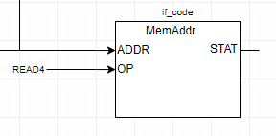
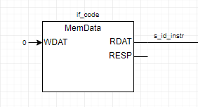
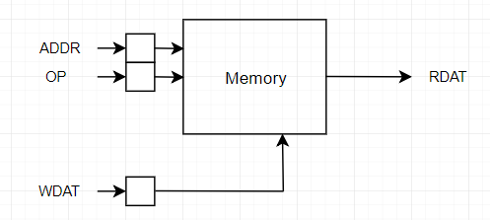
Class Project – Phase 5
Where is the Pipeline Register of the Instruction?
Normally on the IM output
Inside the MemData block
This is the internal implementation, but the memory has 0 delay in this case.
The output must be a signal because the register is implied in the memory block

Slide 8
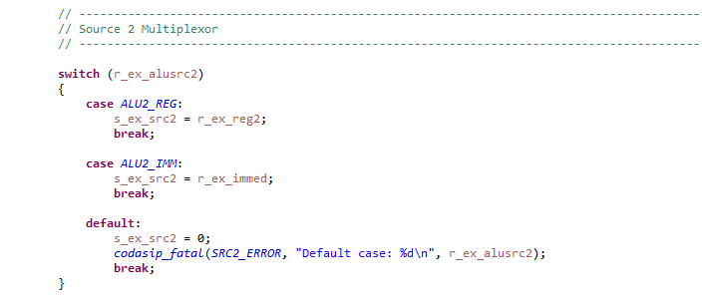
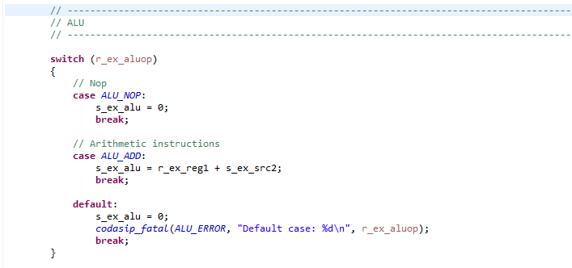
Class Project – Phase 5
Forward References
This is correct

Slide 9
Class Project – Phase 5
Forward References
This is incorrect – it is a FORWARD REFERENCE
Because the Codasip code is executed in order
Important when setting hardware breakpoints

Slide 10
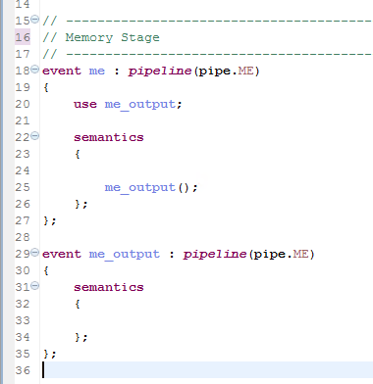

Class Project – Phase 5
Flow of a Stage
Each stage has the event STG_output, which must be “used” before it is called
All the code of the stage goes here EXCEPT for the register updates
Then STG_output is called
The register updates go here
Example – r_wb_pc = r_me_pc;

Slide 11
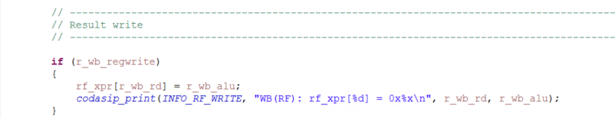
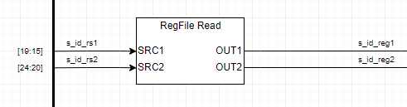
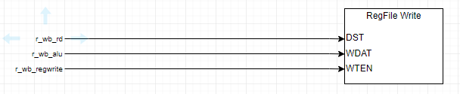
CLASS Project – Phase 5
Register File Implementation
rf_xpr is a 32 x 32-bit array which holds the 32 registers of the Register File
Read (in ID) accesses the selected register indexed by rs1 and rs2
Write (in WB) loads the selected register based on rd
Diagnostic print statement based on “info”
s_id_reg1 != s_id_rs1

Slide 12
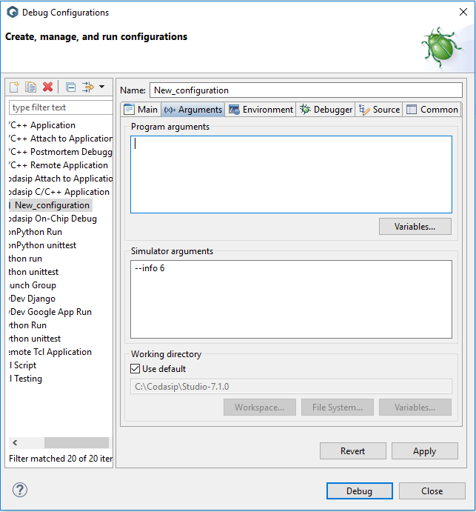
Class Project – Phase 5
Debugging with “- -info”
In Run -> Debug Configurations, can set this in the Arguments tab
Set the “verbosity” level
Can have multiple “verbosity” levels set, e.g. - -info 3,6,7 (no spaces)
Each level prints diagnostic information just before the clock
3 – prints register file writes
6 – prints pipeline instructions
7 – prints ALU inputs/outputs

Slide 13
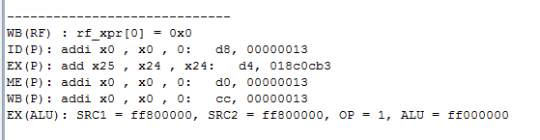
Class Project - -info 3,6,7 Display
Display in console on each cycle
RF Write – 3
Pipeline Display – 6
Current PC
Instruction in hex
ALU Display – 7
See the document in the Debug section of Canvas for a complete description

Slide 14
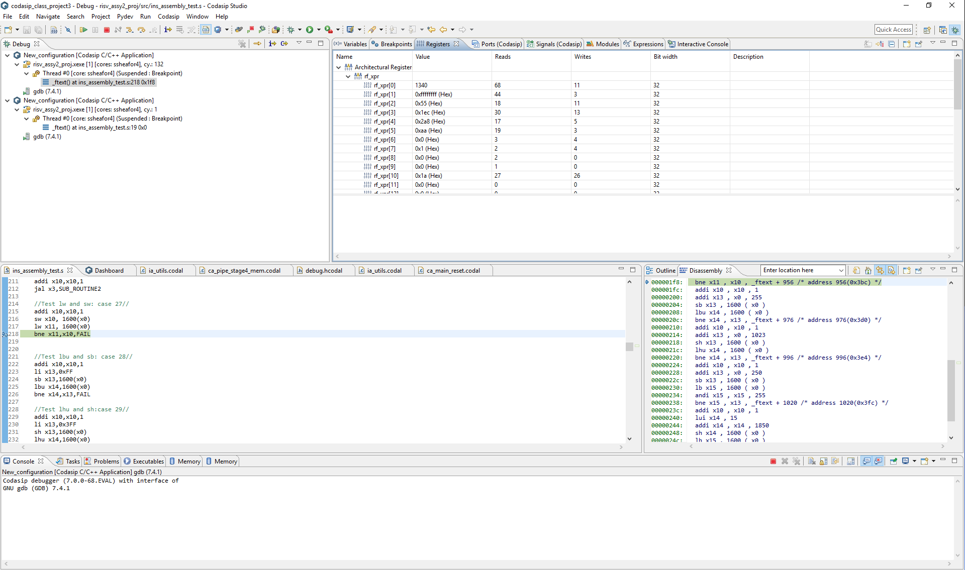
Codasip Debugging – Debug Perspective
Registers, etc.
Code
Disassembly
Console

Slide 15
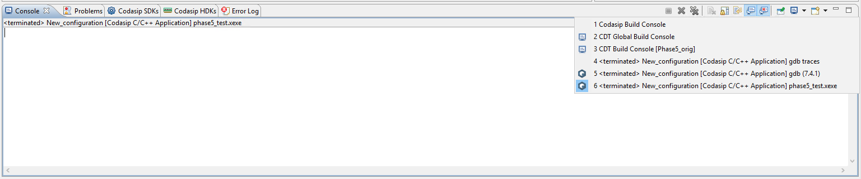
Console Switching
Red error message pops up in Console and then disappears – why?
There are 6 different consoles, selected by the pulldown of the little monitor
gdb (7.4.1) – the Console of the simulator - used in the Debug Perspective
The Red error occurs here
phaseX_test.xexe – outputs from the program - used in the Debug Perspective
But we switch to this instantly
Various build consoles – used in the Codasip Perspective
Codasip will switch consoles unexpectedly
The active console is in the upper left corner
To see the error, switch back to the gdb (7.4.1) Console

Slide 16
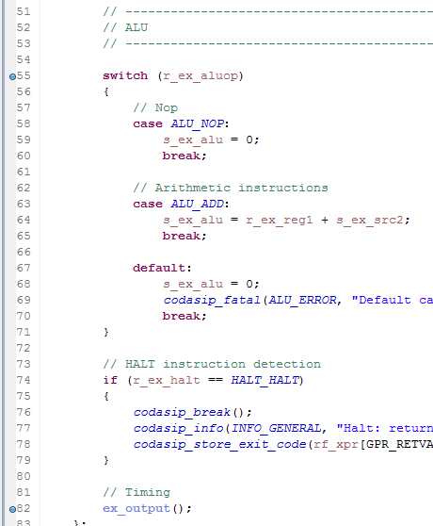
Class Project – Phase 5
Observing signals
Set a HW Breakpoint
Hover over a signal with the mouse
A display of the signal value pops up
You can quickly step through signals
Can only look before the BP, after the code has been executed. This BP is too early

Slide 17
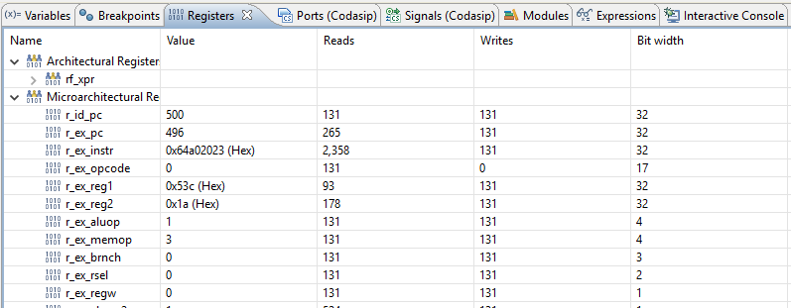
Microarchitectural Register Display

Slide 18
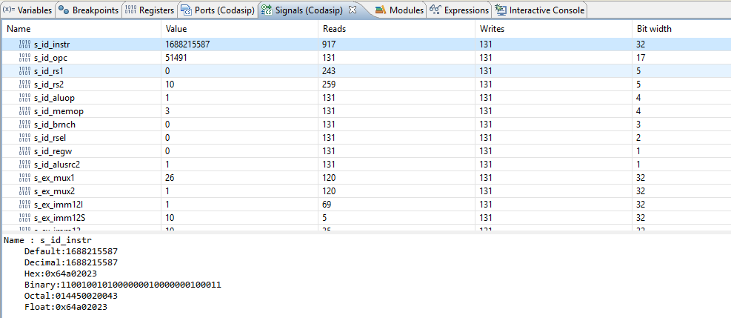
Signal Display

Slide 19
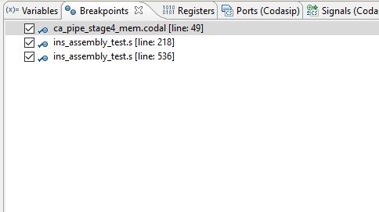
Breakpoints Display

Slide 20
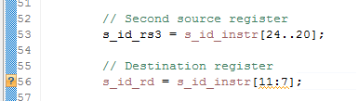
Class Project – Phase 5
Codasip Helps with Debug
Black text => missing
? => Syntax error
Error message often gives error code (click to go to Help)
Error message often gives the correct error location (click to go there)

